Slide 1
Network Programming
K Hari Babu
Department of Computer Science & Information Systems

Slide 2
Outline
POSIX Message Queues
POSIX Semaphores
POSIX Shared Memory

Slide 3
Overview of POSIX IPC (R1: Ch51)

Slide 4
POSIX IPC
Aim was to devise a set of IPC mechanisms that did not suffer the deficiencies of System V IPC.
Message Queues
Semaphores
Shared memory

Slide 5
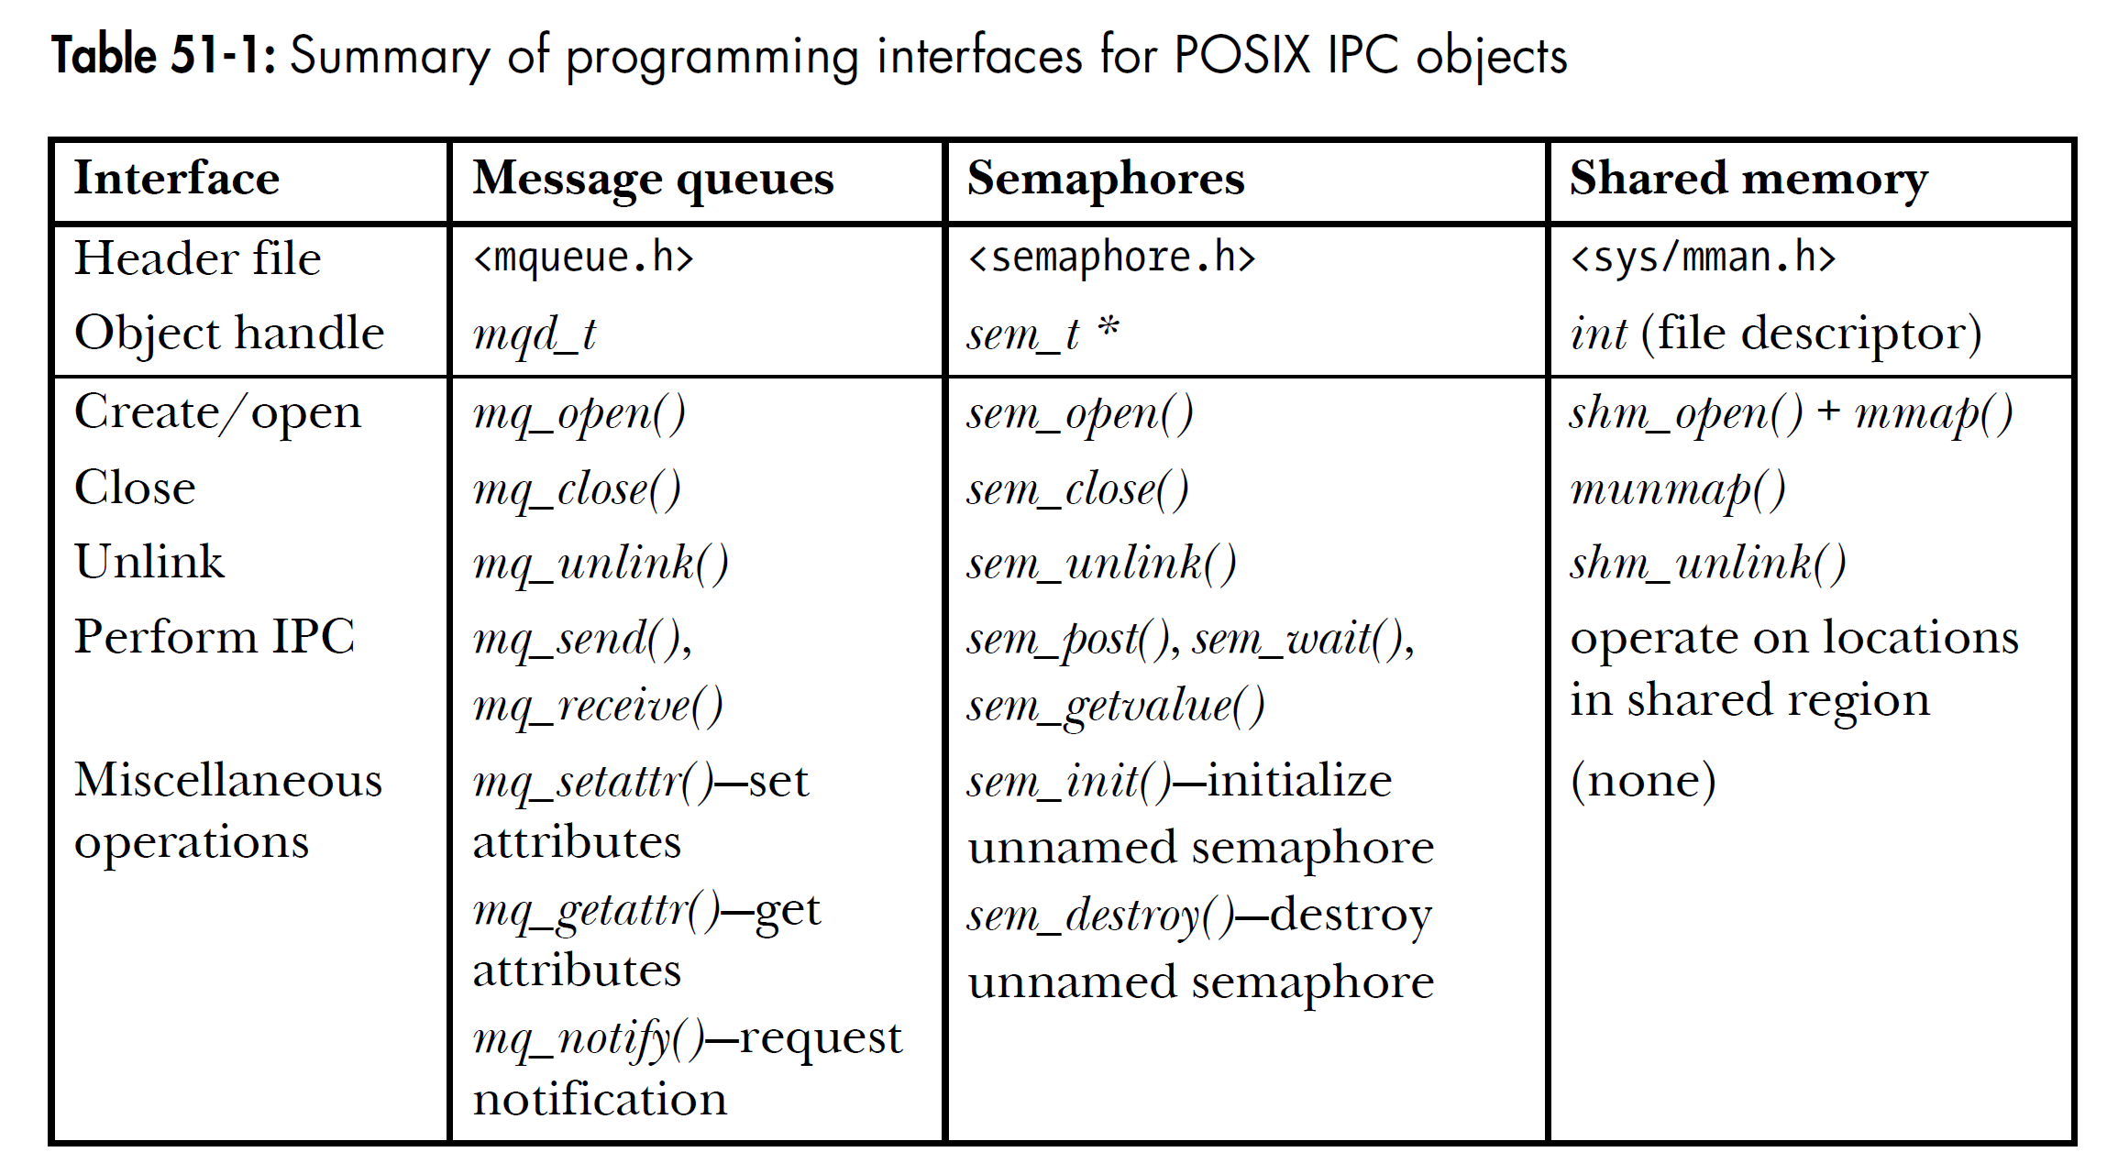
API Overview
All three mechanisms have similar API.

Slide 6
POSIX IPC API
Three stages
Create/open IPC object
Perform operations
Close/remove the object
Create/open IPC object
Each IPC mechanism has an associated open call (mq_open(), sem_open(), or shm_open()),
which is analogous to the traditional UNIX open() system call used for files.

Slide 7
IPC Object Names
Identifying a POSIX IPC object is via a name consisting of an initial slash, followed by one of more nonslash characters;
For example, /myobject.

Slide 8
Closing an IPC object
Close() call that indicates that the calling process has finished using the object.
IPC objects are automatically closed if the process terminates or performs an exec().
As with open files, POSIX IPC objects are reference counted—the kernel maintains a count of the number of open references to the object.
Each IPC object has a corresponding unlink call whose operation is analogous to the traditional unlink() system call for files.
The unlink call immediately removes the object’s name, and then destroys the object once all processes cease using it

Slide 9
Listing All IPC Objects
Listed under the root directory (/), and the standard ls and rm commands can be used to list and remove IPC objects.
Compiling programs that use POSIX IPC on Linux
On Linux, programs employing the POSIX IPC mechanisms must be linked with the realtime library, librt, by specifying the –lrt option to the cc command.

Slide 10
Comparison of System V IPC and POSIX IPC
The POSIX IPC interface is simpler than the System V IPC interface.
The POSIX IPC model—the use of names instead of keys, and the open, close, and unlink functions—is more consistent with the traditional UNIX file model.
POSIX IPC objects are reference counted. This simplifies object deletion, because we can unlink a POSIX IPC object, knowing that it will be destroyed only when all processes have closed it.
There is one notable advantage in favor of System V IPC: portability.

Slide 11
POSIX Message Queues

Slide 12
Message Queues
POSIX message queues are reference counted.
Each System V message has an integer type, and messages can be selected in a variety of ways using msgrcv(). By contrast, POSIX messages have an associated priority, and messages are always strictly queued (and thus received) in priority order.
POSIX message queues provide a feature that allows a process to be asynchronously notified when a message is available on a queue.
On Linux, POSIX message queues can be monitored using poll(), select(), and epoll. System V message queues don’t provide this feature.
POSIX message queues are less portable.
The facility to select System V messages by type provides slightly greater flexibility than the strict priority ordering of POSIX messages.

